Slide 1
File systems 2
Definitions of “file system”
Disk partition
Strategies for allocating disk space to files
Windows file systems
FAT 12,16, 32
NTFS
Linux file systems
Linux file structure on disk
ext2, ext3, ext4, nfs
Virtual file system
Boot sequence

Slide 2
File system
The term can be used to mean any of the following:
A specific implementation such as ext2, NTFS or nsf (disk)
A file system type residing at a location such as /dev/hda4 (tree)
The methods and data structures to map files on a disk or partition (OS)

Slide 3
Partitions
File system instances reside on partitions
Partitioning divides a single hard drive into many logical drives
A partition is a contiguous set of blocks on a drive that are treated as an independent disk
A partition table is an index that relates sections of the hard drive to partitions
Entire Disk
Master Boot
Record
Partition Table
Disk Partitions
Boot Block
Super Block
Inode List
Data Blocks

Slide 4
Why multiple partitions
Partitioning allows the use of different filesystems to be installed for different kinds of files.
Separating user data from system data can prevent the system partition from becoming full and rendering the system unusable.
If one file system gets corrupted, the data outside that filesystem/partition may stay intact, minimizing data loss.
A runaway program that uses up all available space on a non-system filesystem does not fill up critical filesystems
Specific file systems can be mounted with different parameters, e.g., read-only, or read-write, or executable

Slide 5
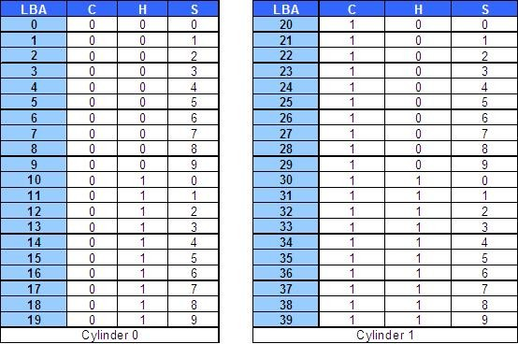
Disk space allocation
Disk drives are addressed as large 1-dimensional arrays of logical blocks, where the logical block is the smallest unit of transfer
The smallest physical unit on disk drives is the sector
Sectors usually have space for 512 bytes, decided during low-level formatting
A block is one or a sequence of sectors.
Assumed: the first sector of a block in the sequence is the address of the block
Windows refers to blocks as clusters

Slide 6
Keeping track of free blocks
Prior to allocate blocks, we must know which blocks are free
Free blocks recording: many approaches exist, 2 describe here
1- use a linked list of disk blocks, each block holding the address of free disk block numbers:
With a 1-KB block and a 32-bit disk block number, each block on the free list holds the numbers of 255 free blocks. (One slot is required for the pointer to the next block.)
A 1-TB disk requires about 4 million blocks.

Slide 7
Keeping track of free blocks
2- Use a bitmap. A disk with n blocks requires a bitmap with n bits.
Free blocks are represented by 1s in the map, allocated blocks by 0s
1-TB disk, we need 1 billion bits for the map, which requires around 130,000 1-KB blocks to store

Slide 8
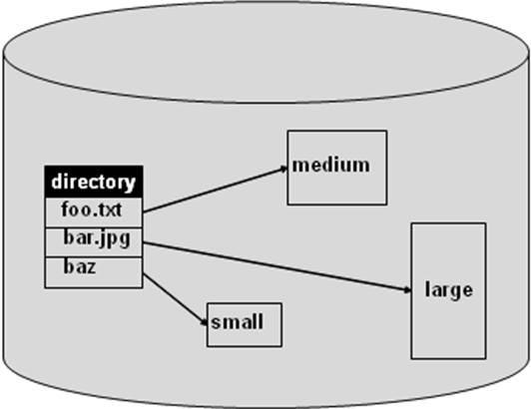
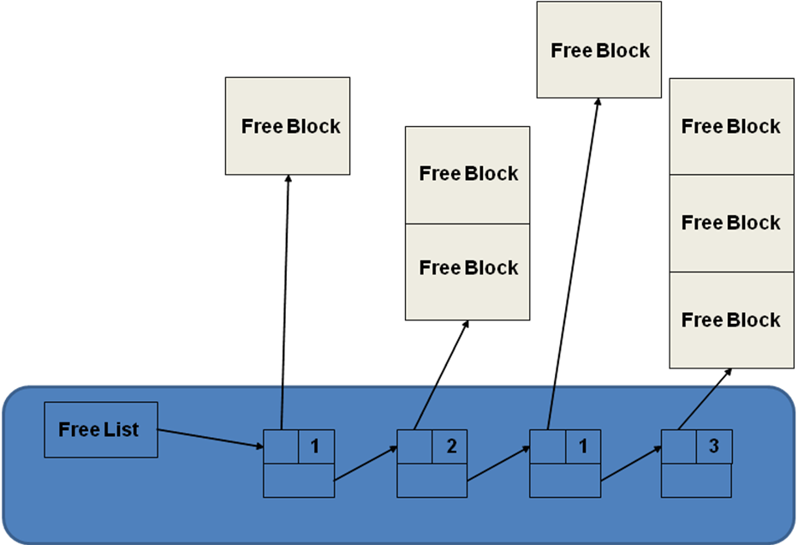
Strategies for disk space allocation to files
Contiguous Allocation
At file creation time, a sequence of blocks is allocated, only remember the address of the first block
File cannot grow beyond that size
Fragmentation a problem
Free list
Allocation may be by first or best fit
Requires periodic compaction

Slide 9
Strategies for disk space allocation to files
Linked list Allocation
Directory only need to store the address of the first block
No compaction required
Sequential access is poor
Need to use space in each block to store the address of the next block allocated to the file
The list of free blocks can be built in the same way

Slide 10
Strategies for disk space allocation to files
File Allocation Table (FAT)
FAT in main memory
The directory has a pointer into the starting block entry in the FAT for each file.
FAT becomes big, use too much main memory
Directory
FAT
0
0
0
File name start index
30
1
70
0
/foo 30
.
.
50
1
-1
/bar 50
0
.
.
70
1
-1
Free/busy next

Slide 11
Strategies for disk space allocation to files
Indexed Allocation
Breaks up FAT into one data structure per file
Allocate an index disk block for each file called an i-node
Directory entries now point to the i-node for that file
Maintain free list as bit vector
Since the i-node is a fixed size there is a maximum file size
Data blocks
Directory
i-node for /foo
100
30
100
File name i-node address
201
/foo 30
201
/bar 50
i-node for /bar
50
99
99

Slide 12
Strategies for disk space allocation to files
Multilevel Indexed Allocation
Make the i-node point to index blocks which point to the files (first-level indirection)
May be extended to two-level (and beyond) indirection
Problem: Accessing even a small file requires a lot of indirection
Data blocks
Directory
100
i-node for /foo
1st level
File name i-node address
30
40
40
100
45
201
201
/foo 30
45
299
299

Slide 13
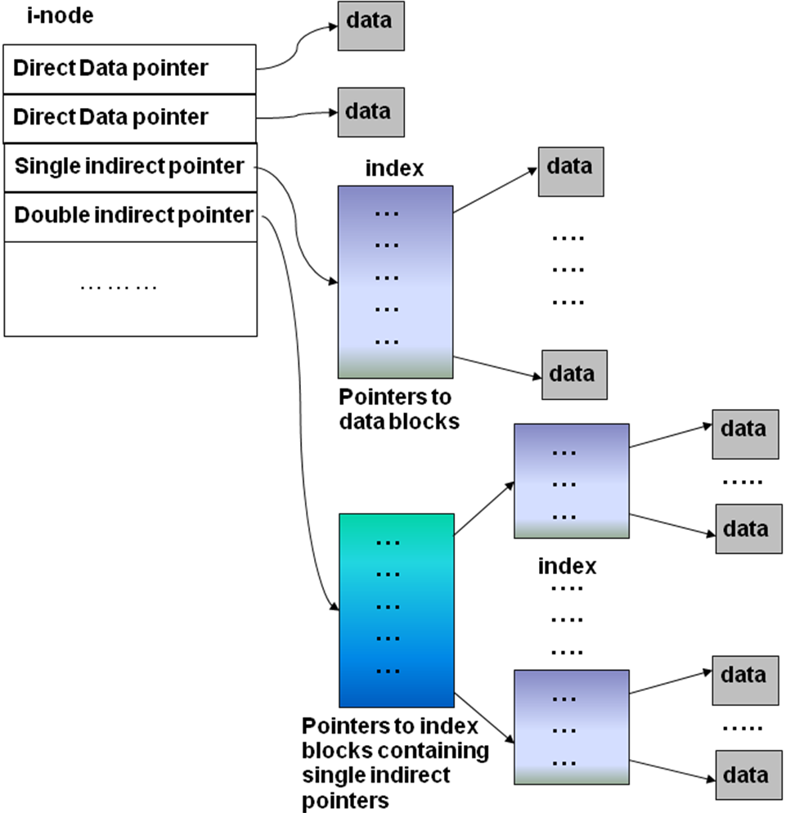
Strategies for disk space allocation to files
Hybrid Indexed Allocation
Two direct pointers for small files
One single indirect
One double indirect
One triple indirect

Slide 14
Strategies for disk space allocation to files
File Attributes
Direct Block
Direct 0
Direct Block
Direct 1
.
.
.
Hybrid Indexed Allocation
Two direct pointers for small files
One single indirect
One double indirect
One triple indirect
Direct 2
Direct 3
Direct 4
Direct Block
Direct 5
Direct 6
Indirect Block
Indirect Block
Indirect Blocks
Direct 7
Direct 8
Inode
Direct 9
Indirect² Blocks
Single Indirect
Inode
Inodes
Double Indirect
Triple Indirect
Indirect³ Blocks
Inode
Inodes
Inodes

Slide 15
Hybrid indexed allocation for a directory
Data blocks
100
i-node for /foo
201
30
direct (100)
direct (201)
single indirect (40)
double indirect (45)
150
triple indirect
40
150
160
160
File
name
i-node
address
60
299
/foo 30
399
299
45
60
70
70
399
Directory

Slide 16
Windows file systems
FAT12, 16, 32, NTFS
FAT stands for file allocation table, which means files are allocated blocks through a table
Each partition hold a FAT for mapping files to physical blocks
The number after FAT indicated the number of bits used to represent an entry in the table
Implicitly this number defines the size of the FAT table as well as the size of the file system (partition)
FAT file systems run under the MS-DOS operating system, the ancestor of Windows

Slide 17
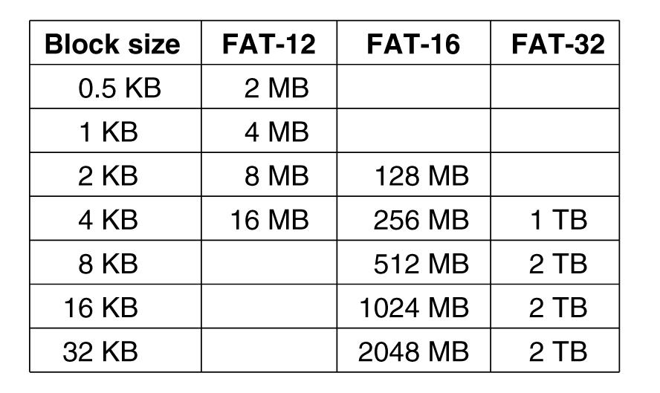
FAT 12
Designed for floppy disks, 1.44MB capacity, block = sector = 512bytes, 2812 sectors
Need 12 bits to address any block
If FAT 12 used with larger drives, need to increase block sizes
FAT 12 was allowed to have new block sizes of 1KB, 2KB and 4 KB
2^{12} = 4096 is the largest number that can be represented with 12 bits
If block size is 4KB, 4 * 2^12 = 16MB, each partition can be 16MB
MS-DOS and Windows only supports 4 disk partitions, C:, D:, E:, F:, thus FAT 12 can address disk drives up to 64 MB

Slide 18
FAT 16, FAT 32
FAT-16 was introduced to handle larger disk drives
Was allowed block sizes 8KB, 16KB and 32KB
2^{32} = 32,768
FAT-16 uses 128KB of main memory per partition
The largest possible disk partition was 2GB
Could address hard drives of 8GB
2GB is just enough for 8 minutes of video!
Starting with Windows 95, FAT-32 file system was introduced

Slide 19
FAT structure on-disk
Boot block, followed by
File Allocation Table (FAT)
12, 16, and 32 bit FAT
Typically two copies of FAT
Root Directory
Fixed size
32 byte Directory Entries
Data area
Once only for file data, later expanded to include subdirectories
Boot Block
FAT-x 1
FAT-x 2
Root directory
Data Blocks

Slide 20
FAT structure on-disk
The boot block contains information about the file system, including how many copies of the FAT tables are present, how big a sector is, how many sectors in a block
The root directory, unlike directories in the data area, has a finite size
for FAT12, 14 sectors * 16 directory entries per sector = 224 entries
Other directories have variable length, but each entry is 32 bytes long
Boot Block
FAT-x 1
FAT-x 2
Root directory
Data Blocks

Slide 21
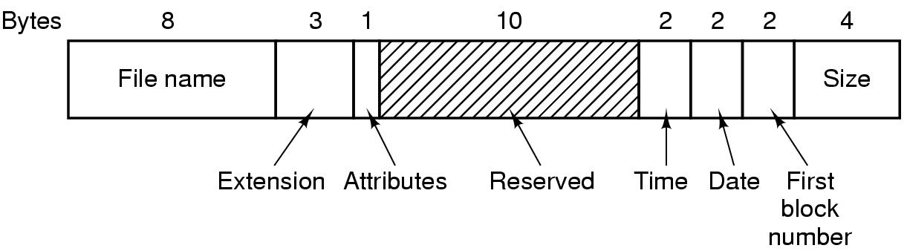
Structure of directory entries
Directory entries are 32 bytes long
A directory entry has the format below:
Attributes: a collection of bit flags:
read only,
hidden,
system file,
root directory,
sub-directory,
file has been archived,
last 2 unused

Slide 22

Windows NTFS
NTFS is the file system currently uses by Windows
Each partition is organized as a linear sequence of blocks, with the block size being fixed for each partition, ranging from 512 bytes to 64 KB, depending on the partition size. Most NTFS disks use 4-KB blocks.
Blocks are referred to by their offset from the start of the partition using 64-bit numbers.
Using this scheme, the system can calculate a physical storage offset (in bytes) by multiplying the block number by the block size.
Each partition is structured as below

Slide 23
NTFS Master file table
The main data structure in each partition is the MFT (Master File Table), an array of fixed-size 1-KB entries.
Each MFT entry describes one file or one directory.
It contains the file’s attributes, such as its name and timestamps, and the list of disk addresses where its blocks are located.
The MFT is itself a file, the file can grow as needed, up to a maximum size of 2^{48} entries.

Slide 24
NTFS Master file
The first 16 MFT entries are reserved for NTFS metadata files
Each of these 16 entry describes a normal file that has attributes and data blocks, just like any other file.
Each of these files has a name that begins with a dollar sign to indicate that it is a metadata file.
Entry 0 describes the MFT file itself. In particular, it tells where the blocks of the MFT file are located so that the system can find the MFT file.
The address of the first MTF block is in the boot block

Slide 25
Some metadata Master file entries
MTF entry 1 is a duplicate of entry 0.
MTF entry 3 contains information about the partition, such as its size, label, and version.
MTF entry 5: the root directory, which itself is a file and can grow to arbitrary length.
Free space on the partition is kept track of with a bitmap. The bitmap is itself a file, and its attributes and disk addresses are given in MFT entry 6.
MTF entry 11 is a directory containing miscellaneous files for things like disk quotas.

Slide 26
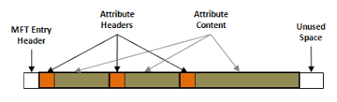
Structure of master file entries
The first 42 bytes store the header. The header contains 12 fields.
The other 982 bytes do not have a fixed structure, and are used to keep attributes.
Each MFT entry consists of a sequence of (attribute header, value) pairs.
Each attribute begins with a header telling which attribute this is and how long the value is.
If the attribute value is short enough to fit in the MFT entry, it is placed there.
If it is too long, it is placed elsewhere on the disk and a pointer to it is placed in the MFT entry

Slide 27
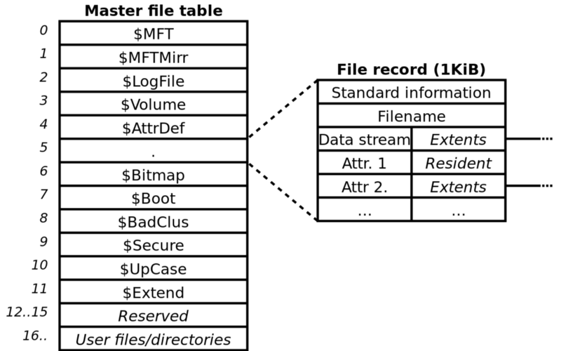
Structure of master file entries
NTFS defines 13 attributes that can appear in MFT entries. Each attribute header identifies the attribute and gives the length and location of the value field

Slide 28
Structure of master file records
The standard information field contains the file owner, security information, the timestamps. This field is always present.
The value of the file name is obviously the name of the file
NTFS files have an ID associated with them that is like the i-node number in UNIX. Files can be opened by ID
An NTFS file has one or more data streams associated with it. For each stream, the stream name, if present, goes in this attribute header. Following the header is either a list of disk addresses telling which blocks the stream contains, or for streams of only a few hundred bytes (and there are many of these), the stream itself.

Slide 29
Structure of master file entries
Usually, attribute values follow their attribute headers directly, but if a value is too long to fit in the MFT entry (like data), it may be put in separate disk blocks.
Such an attribute is said to be a nonresident attribute.
The headers for resident attributes are 24 bytes long
The headers of nonresident attributes are longer because they contain information about where to find the attribute on disk.

Slide 30
NTFS file organization
An NTFS file is not just a linear sequence of bytes, as UNIX files
Instead, a file consists of multiple attributes, each represented by a stream of bytes.
Most files have a few short streams, such as the name of the file and its 64-bit object ID, plus one long (unnamed) stream with the data
However, a file can also have two or more (long) data streams as well.
Each stream has a name consisting of the file name, a colon, and the stream name, as in foo:stream1.

Slide 31
Storage allocation
The blocks in a stream are described by a sequence of records, each one describing a sequence of logically contiguous blocks
Each record begins with a header giving the offset of the first block within the stream. Next is the offset of the first block not in the record
Each record header is followed by one or more pairs, each giving a disk address and run length. The disk address is the offset of the disk block from the start of its partition; the run length is the number of blocks in the run

Slide 32
Unix/Linux files systems
Unix/Linux structure on disk
System calls related to files and directories
Linux ext2, ext3, ext4
The network file system (NFS)
Virtual file system

Slide 33
Linux structure on disk: boot block
Boot Block
Super Block
Inode List
Data Block
Like for Windows file systems, the boot block occupies the beginning of a file system, the first sector
May contain the bootstrap code that is read into the machine at boot time
Only one boot block is required to boot the system, but every file system may contain a boot block
Boot Block
Super Block
Inode List
Data Blocks

Slide 34
Super block
Boot Block
Super Block
Inode List
Data Block
The super block describes the file system:
- Number of bytes in the file system
- Number of files it can store
- Where to find free space in the file system
- Additional data to mange the file system
Boot Block
Super Block
Inode List
Data Blocks

Slide 35
i-nodes
Boot Block
Super Block
Inode List
Data Block
Inode List:
Each i-node is the internal representation of a file, i.e. the mapping of the file to disk blocks
The attributes of the file: owner, permissions, date of creation, etc
The i-node list contains all of the i-nodes present in an instance of a file system
Boot Block
Super Block
Inode List
Data Blocks

Slide 36
Data blocks
Boot Block
Super Block
Inode List
Data Block
Data Blocks:
Contain the file data in the file system
Additional administrative data
An allocated data block can belong to one and only one file in the file system
Boot Block
Super Block
Inode List
Data Blocks

Slide 37
System Calls related to files
Linux system calls relate to files and the file system

Slide 38
System Calls related to directories
Link system call: linking to a file creates a new directory entry that points to an existing file
Directory entries are removed with unlink.
When the last link to a file is removed, the file is automatically deleted. For a file that has never been linked, the first unlink causes it to disappear

Slide 39
The Linux ext2 file system
Linux supports over 130 different file systems, the standard Linux file system is known as the extended file system, with the most common versions being ext2, ext3 and ext4
ext2 divides the logical partition that it occupies into Block Groups, the file system has the disk layout has shown below
Each group includes data blocks and inodes stored in adjacent tracks.
This structure allow files stored in a single block group to be accessed with a lower average disk seek time

Slide 40
The Linux ext2 file system
Block 0 (boot block) is not used by Linux, contains code to boot the computer
All block groups in the filesystem have the same size and are stored sequentially
The block groups have the layout as below:
Superblock: Contains a copy of the of the filesystem’s superblock for the partition
Group descriptor: Contains information about the location of the bitmaps, the number of free blocks and i-nodes in the group, the number of directories in the group

Slide 41
The Linux ext2 file system
Two bitmaps are used to keep track of the free blocks and free i-nodes
Block bitmap identifies the free blocks inside the group
i-node bitmap identifies the free i-nodes inside the group
Each map is one block long. With a 1-KB block, this design limits a partition to 8192 blocks and 8192 i-nodes
i-nodes are 128 bytes long

Slide 42
Structure of the directory entries
The file must be opened using the file’s path name. The path name is parsed to extract individual directories.
Each directory entry consists of four fixed-length fields and one variable-length field.
The first field is the i-node number, 19 for the file colossal, 42 for the file voluminous, and 88 for the directory bigdir.
Next comes a field rec len, telling how big the entry is (in bytes),
Next, the type field: file, directory
Last field is the length of the actual file name in bytes, 8, 10, and 6 in this example

Slide 43
Structure of i-nodes
The i-node number of a file is used as an index into the i-node table (on disk) to locate the corresponding i-node and bring it into memory.
The i-node is put in the i-node table, a kernel data structure that holds all the i-nodes for currently open files and directories. The format of the i-node entries, must contain all the fields returned by the stat system call

Slide 44
Structure of i-nodes
Not shown in the previous table is the pointers to the blocks holding the file
The i-node contains the disk addresses of the first 12 blocks of a file.
If the file position pointer falls in the first 12 blocks, the block is read and the data are copied to the user.
For files longer than 12 blocks, a field in the i-node contains the disk address of a single indirect block. This block contains the disk addresses of more disk blocks.
For example, if a block is 1 KB and a disk address is 4 bytes, the single indirect block can hold 256 disk addresses. Thus this scheme works for files of up to 268 KB.
Beyond that, a double indirect block is used. It contains the addresses of 256 single indirect blocks, each of which holds the addresses of 256 data blocks. This mechanism is sufficient to handle files up to 10 + 216 blocks (67,119,104 bytes)
Triple indirect block. can handle file sizes of 16 GB for 1-KB blocks. For 8-KB block sizes, the addressing scheme can support file sizes up to 64 TB.

Slide 45
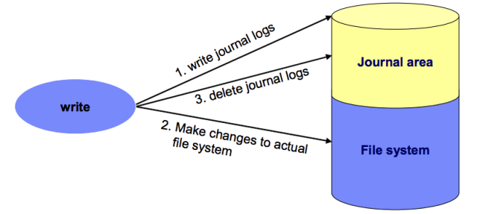
ext3 and ext4
Like Windows NTFS, ext3 and ext4 are “journaling file systems”
For example, deleting a file on a Unix file system involves three steps:
1- Removing its directory entry.
2- Releasing the inode to the pool of free inodes.
3- Returning all disk blocks to the pool of free disk blocks.
If a crash occurs after step 1 and before step 2, there will be an orphaned inode; if a crash occurs between steps 2 and 3, then the blocks previously used by the file cannot be used for new files
A journaled file system allocates a special area—the journal—in which it records the changes it will make ahead of time. After a crash, recovery simply involves reading the journal from the file system and replaying changes from this journal until the file system is consistent again.

Slide 46
NFS: The Network File System
Is used to join the file systems on separate computers into one logical file system.
The basic idea behind NFS is to allow an arbitrary collection of clients and servers to share a common file system

Slide 47
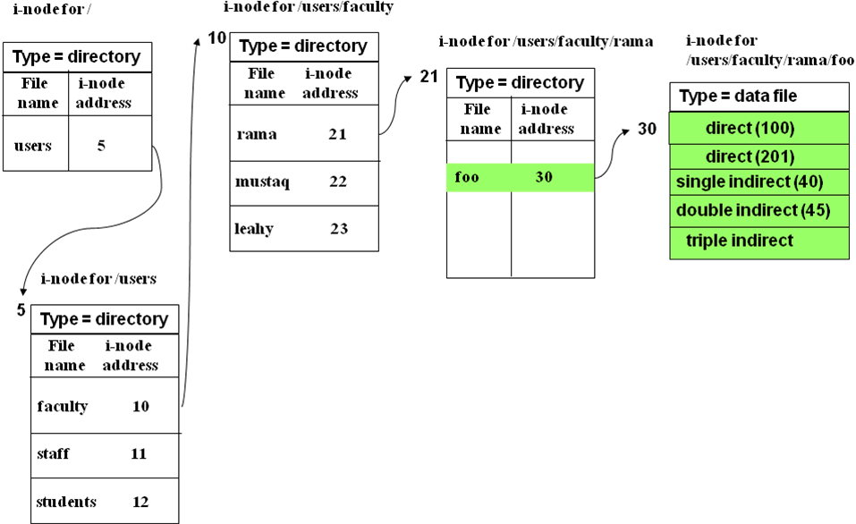
Unix/Linux hierarchical file naming
Linux hierarchical naming:
/users/faculty/rama/foo
Each part of the file name corresponds to an i-node which form part of a tree like structure where all but the leaf nodes are directory files (which are i-nodes)
Each directory entry contains a type which indicates if it is a directory or a data file

Slide 48
Relation between file descriptors and i-nodes: Linux

Slide 49
Summary: On disk organization of file systems
Boot block: MS-DOS and Unix/Linux: Boot block; NTFS: Boot sector
Control block: partition details such as number of blocks in partition, size of the blocks, number of free-blocks, pointers to free-blocks: NTFS: Master file table; Linux: Superblock
A mapping of files to blocks: NTFS: Master file table; Linux: i-nodes; FAT-x: File allocation table
Boot Block
FAT-x 1
FAT-x 2
Root directory
Data Blocks
Boot Block
Super Block
Inode List
Data Blocks

Slide 50
Summary: in-memory file system data structures
Main memory keeps information about the file system for both file-system management and performance improvement via caching
An in-memory mount table contains information about each file system mounts, mount points, file system types, etc
The system-wide open-file table contains a pointer to the i-node of each open file, as well as other information
The per-process open-file table (Linux file descriptor, fd) (Windows file handle) which contains pointers to the appropriate entries in the system-wide open-file table, as well as other information, for all files the process has opened
v-nodes table, which has one entry per i-node of open files, it contains the information stored in the i-nodes copied from the disk as well as some other information

Slide 51
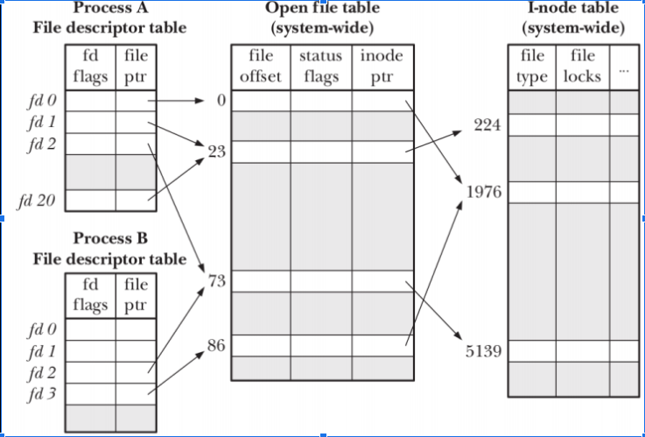
Some of the in-memory file system data structures

Slide 52
General file systems
A general-purpose computer system can have multiple storage devices:
HDD (or SSD), DVD drive, floppy, USB drive, network servers, etc
Those devices can be sliced up into partitions, which in turn hold file systems
Computer systems may also have varying numbers of file systems, and the file systems may be of varying types

Slide 53
Different Solaris file systems
tmpfs—a “temporary” file system that is created in volatile main memory and has its contents erased if the system reboots or crashes
procfs—a virtual file system that presents information on all processes as a file system
ufs, zfs—general-purpose file systems

Slide 54
General file systems
The question arises of how to handle these different file systems.
One solution is to put a self-contained file system on each device/partition and just keep them separate.
This is what Windows does, by identifying each device/partition with a different drive letter, as in C:, D:, etc.
When a process opens a file, the drive letter is explicitly or implicitly present, so Windows knows which file system to pass the request to.
The Unix/Linux solution is to allow one device/partition to be mounted in another device/partition’s file tree
The user sees a single file tree, and doesn’t have to be aware of which file resides on which device

Slide 55
File system mounting
Whether it is Unix/Linux or Windows OS system, a file system must be mounted before it can be available to processes of the OS
The mount procedure is straightforward.
The operating system is given the name of the device and the mount point, i.e. the location within the file structure where the file system is to be attached
Typically, a mount point is an empty directory.

Slide 56
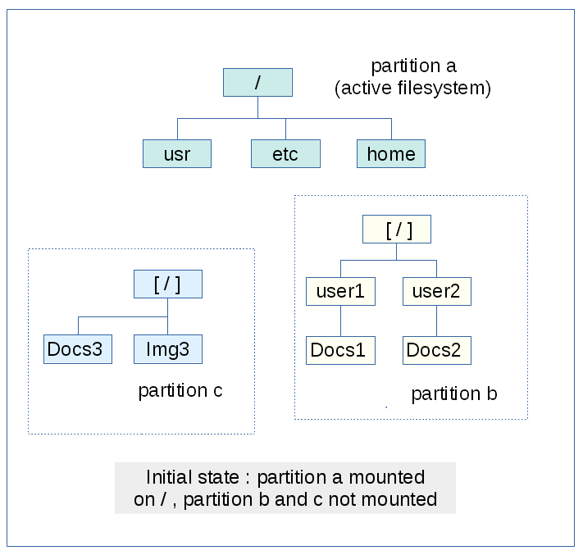
Mounting a file system
Assume we want to mount the file system on one of the disk partitions.
First a mount point must be selected, i.e. a directory in the filesystem.
The side picture describe the file systems on 3 partitions

Slide 57
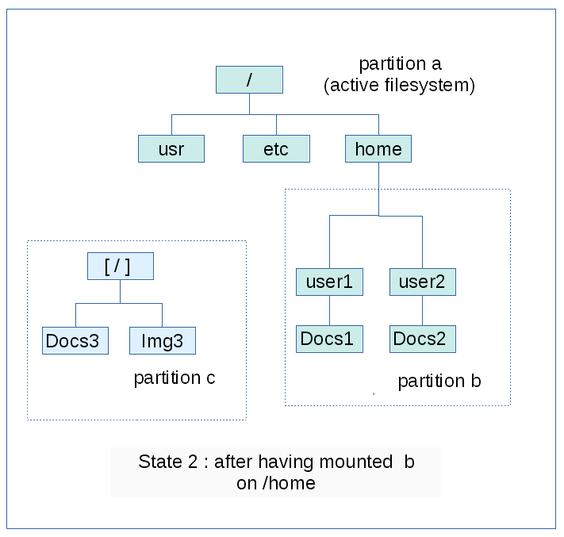
Mounting a file system
The file system of partition b has been mounted in the directory /home

Slide 58
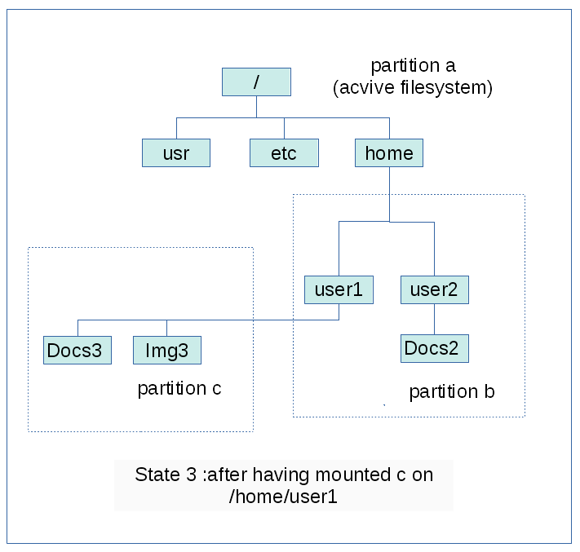
Mounting a file system
Here the file system of partition c has been mounted in /home/user1
Note, the subdirectory Docs1 has disappeared, this is what happens when a file system is mounted in a directory that is not empty

Slide 59
Mounting a file system: the device side
Beside the mounting point, the operating system must be given the name of the device (partitions, USB keys, etc)
In Linux, the names of the devices are in /dev
sda for the disk partitions, sda1, sda2 for partitions 1 or 2,
sdb for USB key
cdrom
fd for floppy disks
To mount a USB key, the device /dev/sdb of the file system is combined with the mount point /mnt/media directory using:
sudo mount /dev/sdb /mnt/media

Slide 60
Windows: mounting file system
Windows–based systems mount each partition with a separate name, denoted by a letter and a colon such as C:
To record that a file system is mounted at C:, for example, the operating system places a pointer to the file system in a field of the mount table corresponding to C:.
When a process specifies the driver letter, the operating system finds the appropriate file-system pointer and traverses the directory structures on that device to find the specified file or directory.
One can find all the Windows partitions by right-click the Start button and select Disk Management.
2 hidden partitions that holds information about the system boot file and the disk boot sector in case of system failure. It is the part of the hard disk that is not displayed or used directly under normal conditions.

Slide 61
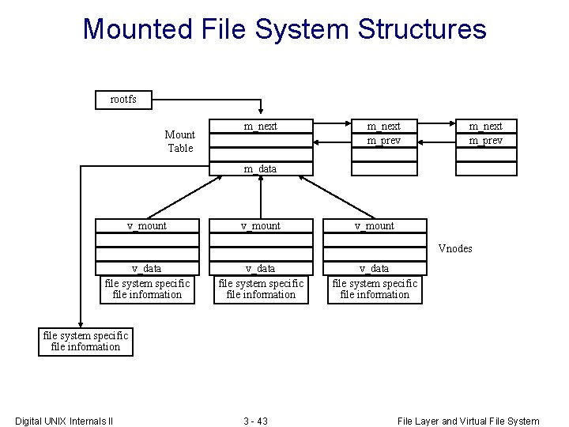
Unix/Linux: Mounting file system
File systems can be mounted at any directory.
Mounting is implemented by setting a flag in the in-memory copy of the inode (v-node) for that directory.
The flag indicates that the directory is a mount point.
A field then points to an entry in the mount table, indicating which device is mounted there.
The mount table entry contains a pointer to the superblock of the file system on that device.

Slide 62

Boot sequence
CPU reads and executes a sequence of instructions from the BIOS, a program on a small memory cheap sitting on the motherboard
Among these instructions, some request the CPU to load the first sector of the hard disk, the master boot record (MBR)
The first thing the MBR program does is locate the active partition, read in its first block, which is called the boot block, and execute it.
The program in the boot block loads the operating system contained in that partition

Slide 63
Boot sequence
The end of the MBR contains the partition table. This table gives the starting and ending addresses of each partition.
One of the partitions in the table is marked as active.

Slide 64
Boot sequence
The first thing the MBR program does is locate the active partition, read in its first block, which is called the boot block, and execute it.
The program in the boot block loads the operating system contained in that partition
Usually, the file system of the boot partition, the one selected by the boot block, is mounted at boot time.
Other partitions can be automatically mounted at boot or manually mounted later

